Slide 1

Flight Fare Prediction Using Machine Learning

Slide 2
Overview
We will be analyzing the flight fare prediction using machine learning dataset using essential data analysis techniques and then will draw predictions about the price of the flight based on some features such as type of airlines, arrival time, departure time and more.
About the Dataset
The dataset has following columns:
Airline,Date_of_journey,Source,Destination,Route,Arrival_time,Duration,Total_stops,Additional info,Price

Slide 3
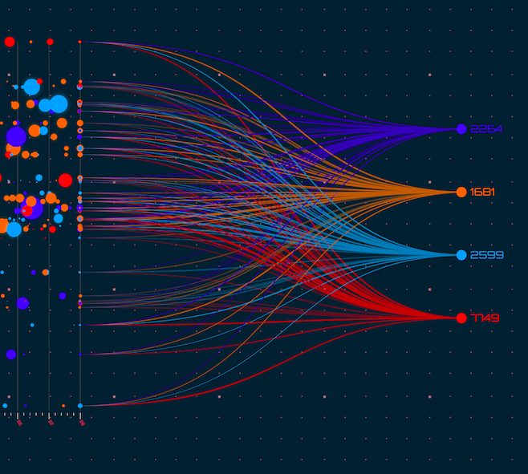
Takeaways from the project
EDA : Learn the complete process of exploratory Data analysis
Data analysis : Learn to withdraw some insights from the dataset both mathematically and visualize it.
Data Visualization :Visualizing the data to get better insights from it.
Feature Engineering :Machine learning technique that leverages data to create new variables that aren't in the training set. It can produce new features for both supervised and unsupervised learning, with the goal of simplifying and speeding up data transformations while also enhancing model accuracy.

Slide 4
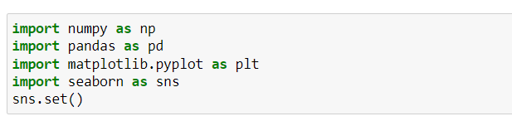
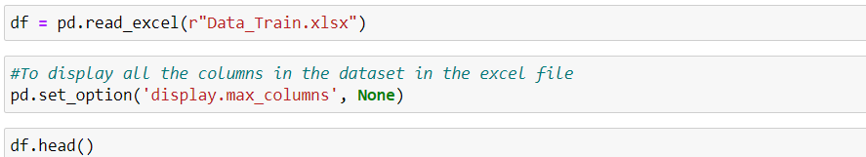
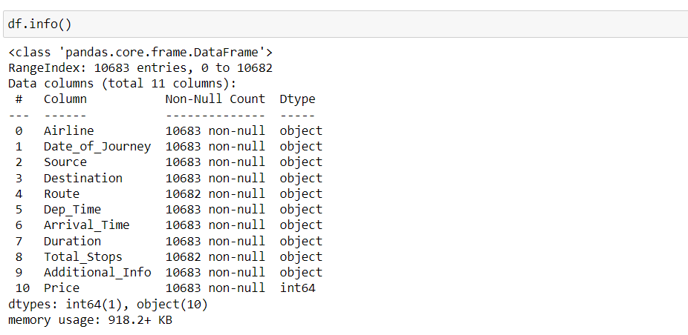
Importing the libraries and reading the dataset
Since data is in form of excel file we have to use pandas read_excel to load the data
Check whether any null values are there or not
Describe data --> which can give statistical analysis

Slide 5
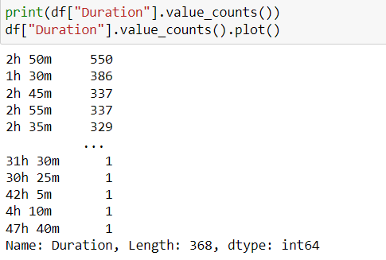
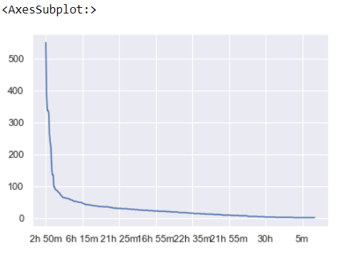
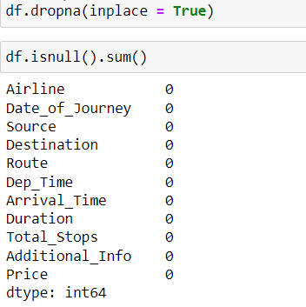
Understanding the data set
In order to understand the data in deep we plot a simple graph with the duration to understand the count .
We can infer that there are more flights with the duration 2h 50 m and the graph gradually decreasing afterwards
We also check for the null values in the data set

Slide 6
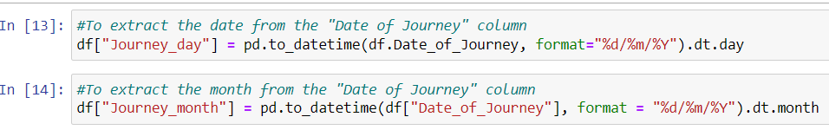
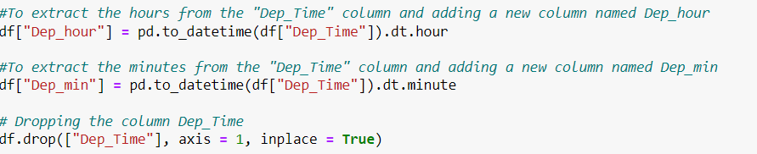
EDA
From description we can see that Date_of_Journey is a object data type,\
Therefore, we have to convert this datatype into timestamp so as to use this column properly for prediction
For this we require pandas **to_datetime** to convert object data type to datetime type.
Since we have converted Date_of_Journey column into integers, Now we can drop as it is of no use.
Similar to Date_of_Journey, we can extract values from Dep_Time

Slide 7
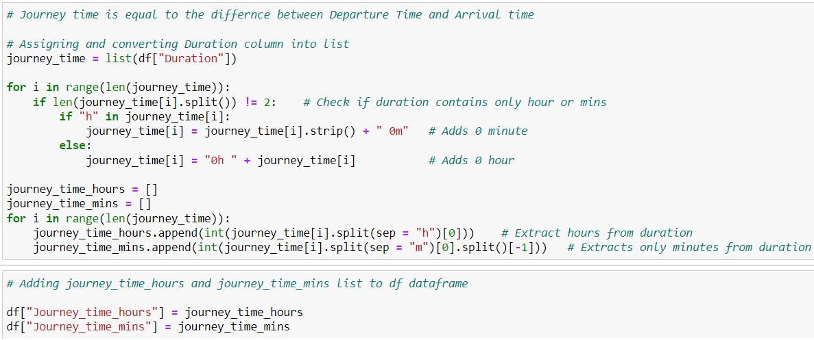
Continued..
Journey time is equal to the difference between Departure Time and Arrival
Adding journey_time_hours and journey_time_mins list to df dataframe
Drop the duration column

Slide 8
Handling categorical data
There are many ways to handle categorical data. Some of them categorical data are :
Nominal data** --> data are not in any order --> **OneHotEncoder** is used in this case
Ordinal data** --> data are in order --> **LabelEncoder** is also used in this case
One hot encoding is a common way of preprocessing categorical features for machine learning models.This type of encoding creates a new binary feature for each possible category and assigns a value of 1 to the feature of each sample that corresponds to its original category.
One hot encoding makes our training data more useful and expressive ,and it can rescaled easily. Here to handle categorical data we use OneHotEncoding because the variables do not have any relation with each other.
Label encoding refers to converting the labels into a numeric form to convert them into the machine-readable form.
Machine learning algorithms can then decide in a better way how those labels must be operated. It is an important pre-processing step for the structured dataset in supervised learning

Slide 9
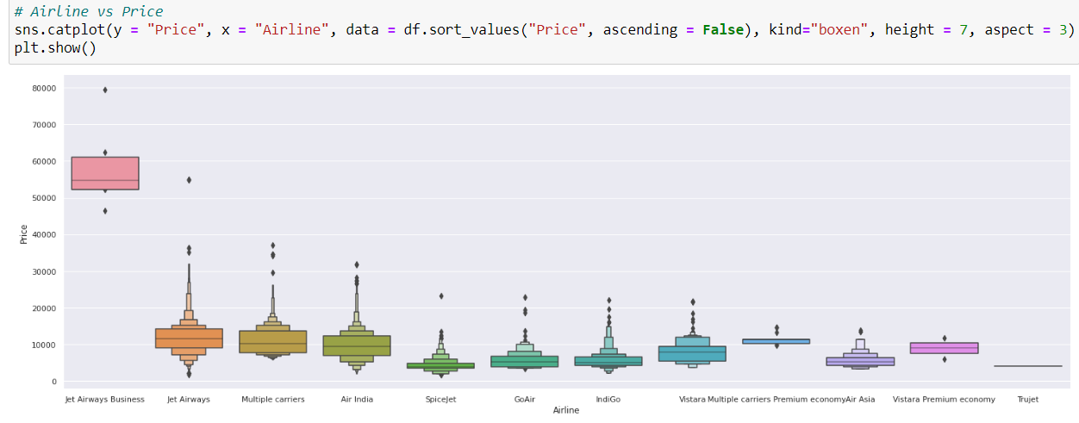
Handling categorical variable
Here to handle categorical data we use OneHotEncoding because the variables do not have any relation with each other
The catplot provides access to several axes-level functions that show the relationship between the numerical and categorical variables. In this case its between categorical variable ‘Airlines’ and numerical variable ‘Price’
From graph we can see that Jet Airways Business have the highest Price.
Apart from the first Airline almost all are having similar median

Slide 10
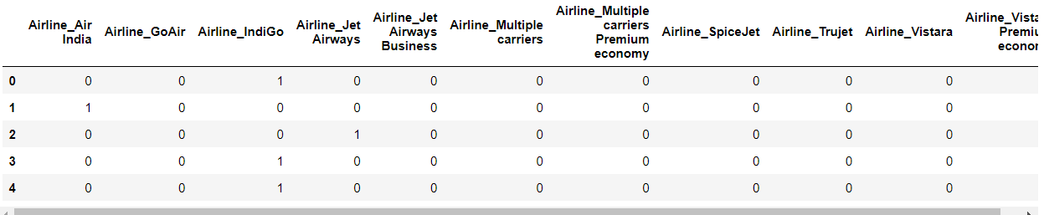
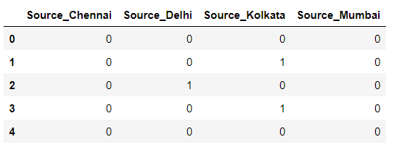
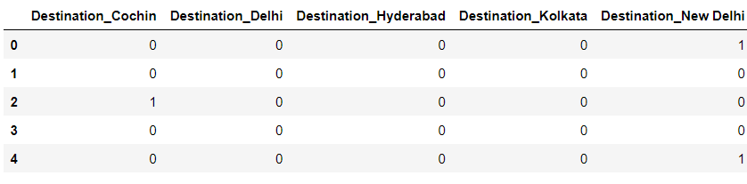
One hot Encoding
Airline is Nominal Categorical data, OneHotEncoding is performed
As Source is Nominal Categorical data, we will perform OneHotEncoding
As Destination is Nominal Categorical data, we will perform OneHotEncoding

Slide 11
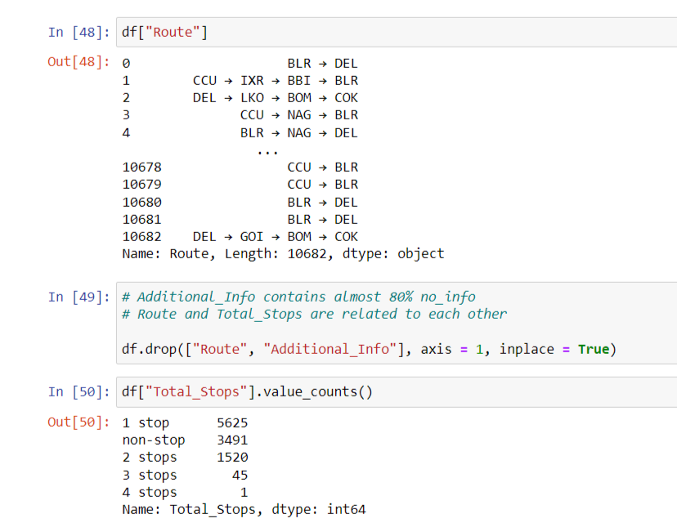
Remove unnecessary data
In Route and Total_stops, data are similar to each other, so we can say that both column are related to each other.
More than 80% of no_info data predict in Additional_info column.
So we will drop Route and Additional_info column.

Slide 12
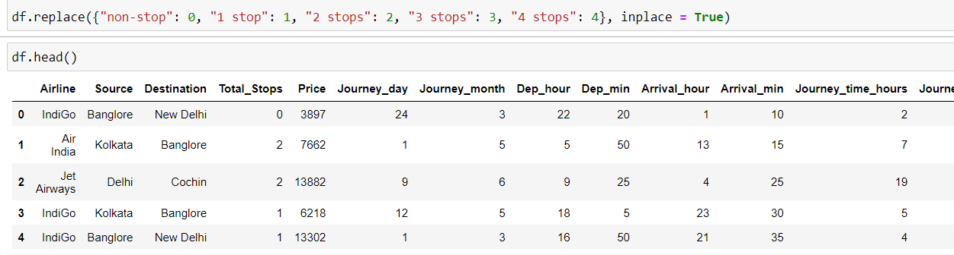
Label Encoding
From the dataset we can infer that route and total stops are related to each other.
As this is case of Ordinal Categorical type we perform LabelEncoder
Here Values are assigned with corresponding keys

Slide 13
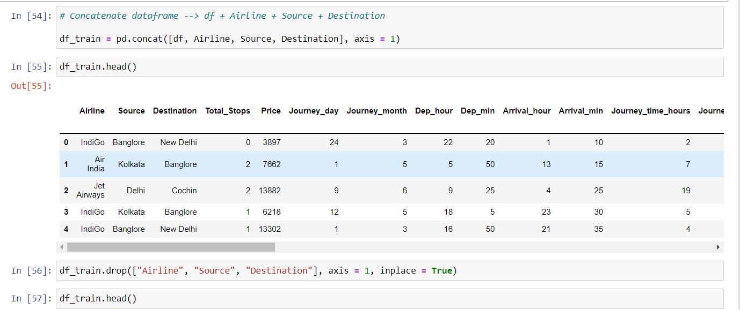
Concatenate dataframe
we will concatenate information of destination, source, airline and create new variable which is called df_train.
Before, we have already converted information of destination, source, airline in integer or one hot encoding.
So, we will drop these three columns

Slide 14
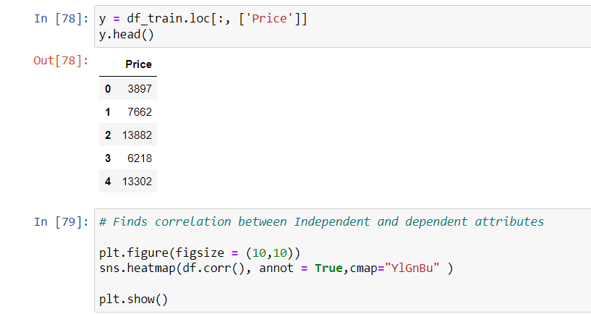
Feature selection
To perform the best model on this problem as it unknowable, we used Extra tree Regressor, RandomizedSearchCV, Random Forest Regression Model (Feature Selection) on the train set.
We can try any number of regression models and choose one among them which is the best suitable.
After that, we will drop the “price” column from train dataset and make (y)independent variable to find correlation between dependent and independent data. After cleaning the data, we can visualize data and better understand the relationships between different variables.

Slide 15
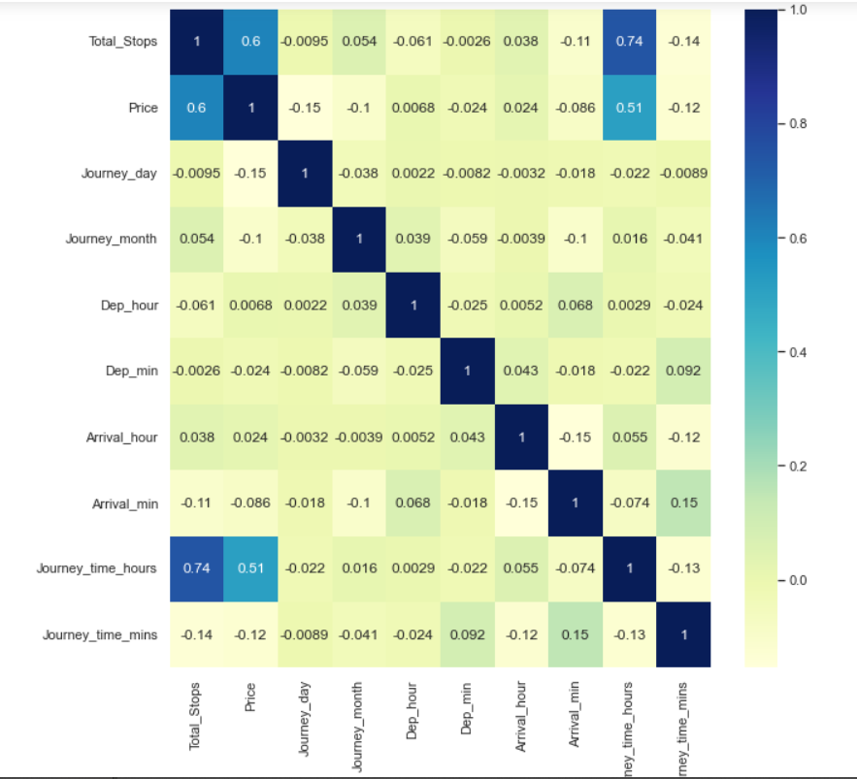
Heatmap Visualization using Seaborn
Using sns.heatmap(), we can see that the ‘Total_Stops’ is positively correlated with ‘Price’ which leads to increase in cost of fuel and increase the price.
Also, Total_stops is highly correlated with Duration_hours means if the no. of stops would increase, the duration hours of the flight will also increase.

Slide 16
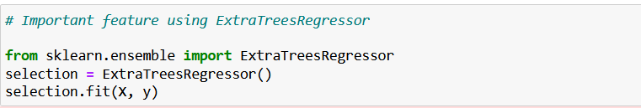
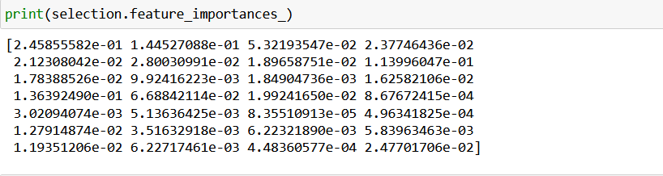
Extra Tree Regressor
Extra Tree Regressor fits a number of randomized decision trees on various sub-samples of the dataset and uses averaging to improve the predictive accuracy and control over-fitting.
Using the “feature_importances_” property of the extra tree regressor
Which implies the higher the value of the feature more important it is.

Slide 17
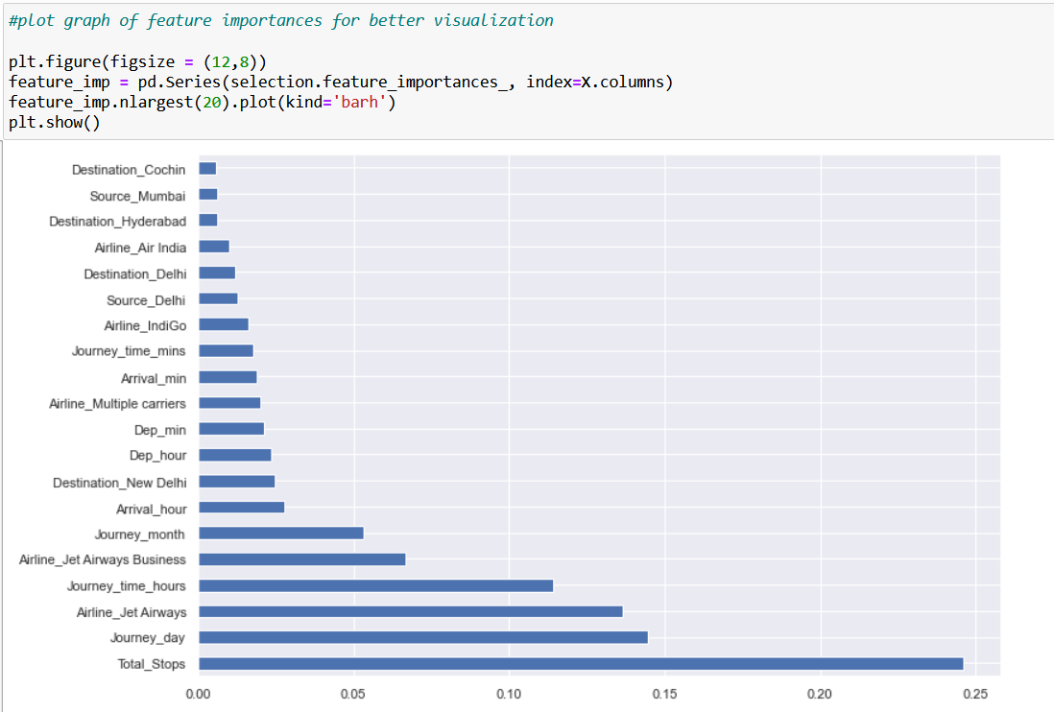
Continued..
As Shown in the Graph the most important feature for our Target is the Total Number of stops.

Slide 18
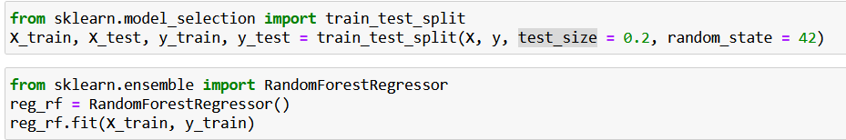
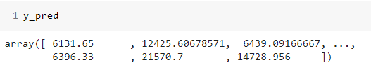
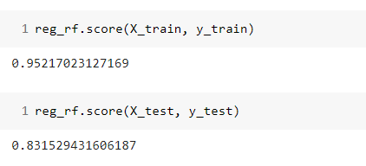
Fitting model using Random Forest
Random Forest uses Decision trees to process and train the data.
Here y_pred is the predicted price for the test dataset.
A number of decision trees are generated and the agregate of those decisions are chosen to finalize the random forest method results.
The reason why we do not use the decision tree classification is that it has its disadvantages such as overfitting and bias.
To overcome that issues the Random forest method is used which reduces the overfitting and bias.

Slide 19
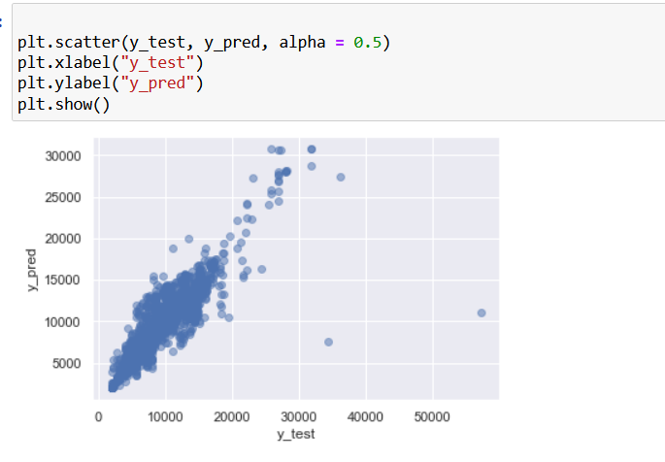
Scatter Graph for Visualizing the data
The Graph shows the relation between the actual price and the predicted price of flights.
As we have acheived more than 80% accuracy, we can see the data is overlapping at most of the points.

Slide 20
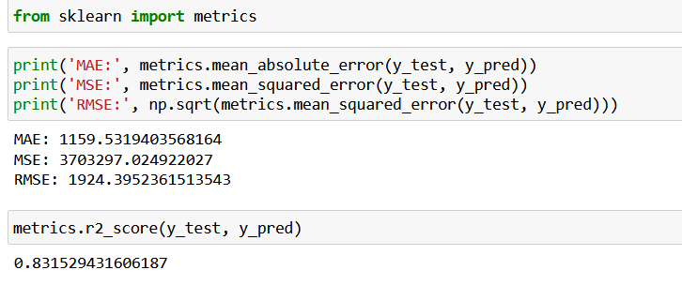
Calculating the Accuracy
We have Succesfully achieved more than 80 % Accuracy.
Further more we can minimize the error and maximize the model perfomance by few methods.

Slide 21
THANK YOU

